Slide 1
What is the Cost of Packaging
Mr. Philip Morris

Slide 2
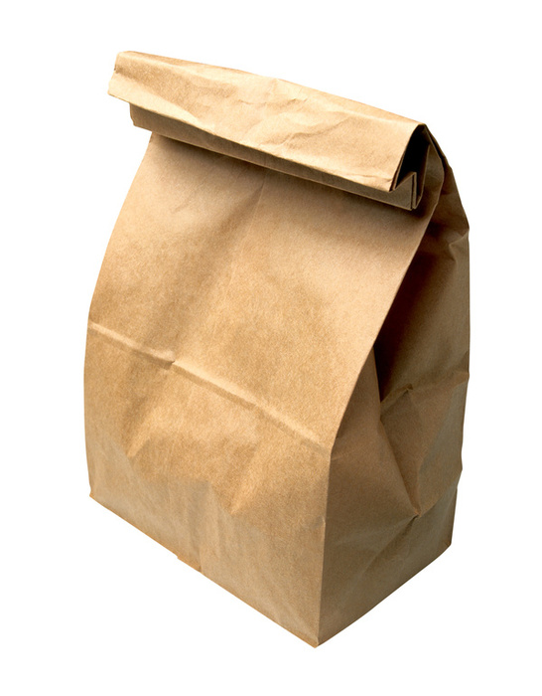
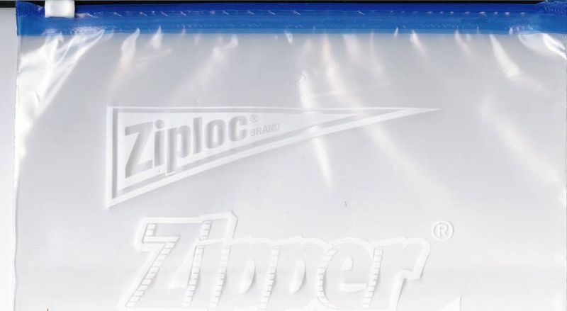
What’s your order?
Cost of Packaging

Slide 3
How Would You Order Them?
Discussion point
Which has the highest cost of production?
Which has the highest cost to the environment?
Which has the highest cost to consumer?

Slide 4
Renewable Energy Video
https://youtu.be/KEeH4EniM3E

Slide 5
Natural Resources: Plastic
https://www.youtube.com/watch?v=f3BjWvTT9Ro

Slide 6
Natural Resources: Plastic-Drilling/Fracking Oil Products

Slide 7
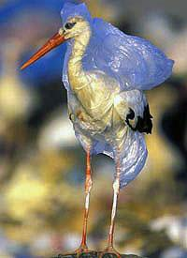
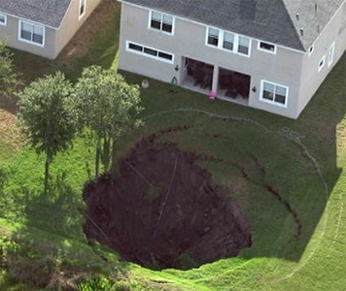
Plastic-Cost to Animals/Environment

Slide 8
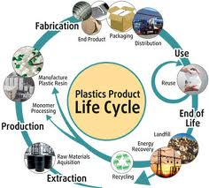
Plastic-Production and Transportation
Plastic
production
process

Slide 9
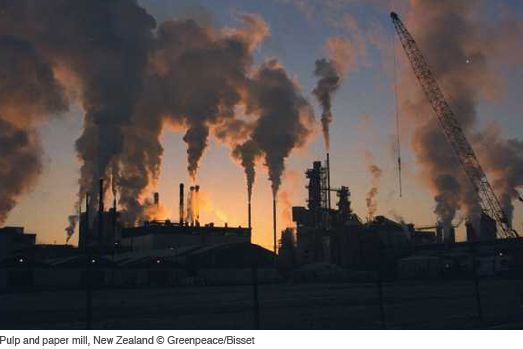
Plastic-Energy to Produce/Recycle

Slide 10
Natural Resources: Paper Products/Cardboard
https://www.youtube.com/watch?v=7IP0Ch1Va44

Slide 11
Natural resources: Paper Products/Cardboard -Trees

Slide 12
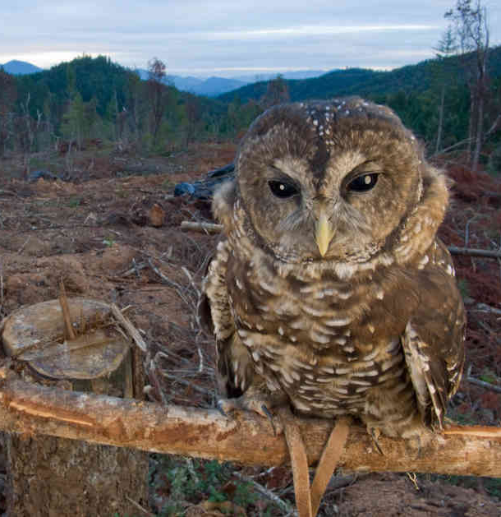
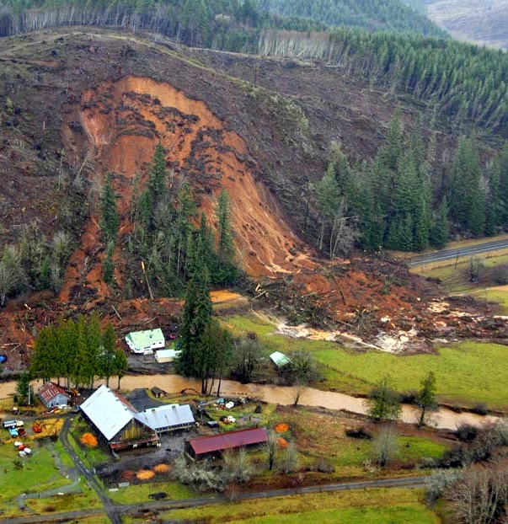
Paper Products/Cardboard -Cost to Animals/Environment

Slide 13
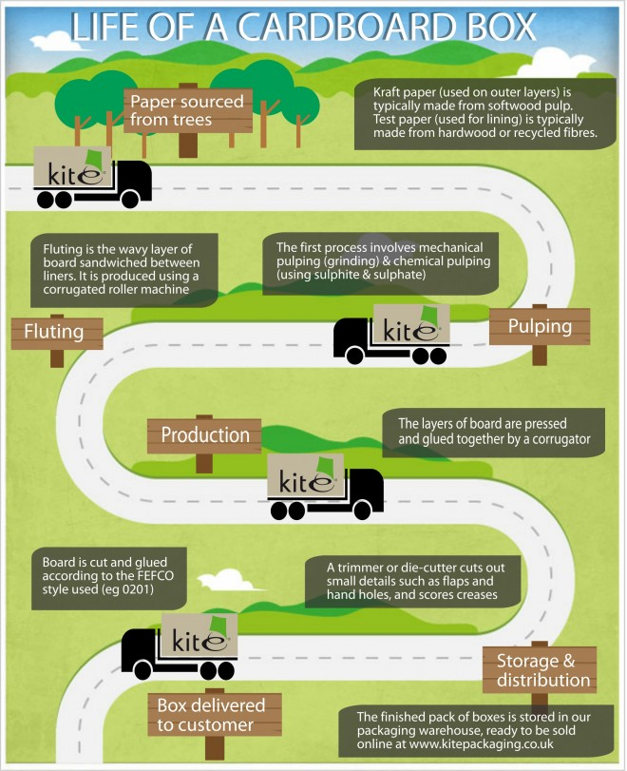
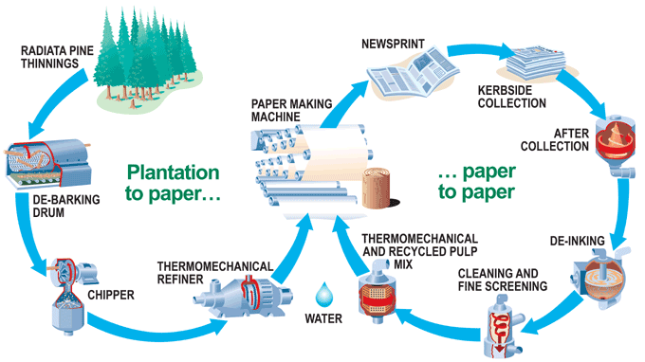
Paper Products/Cardboard-Production and Transportation
Paper Products/Cardboard-production process

Slide 14
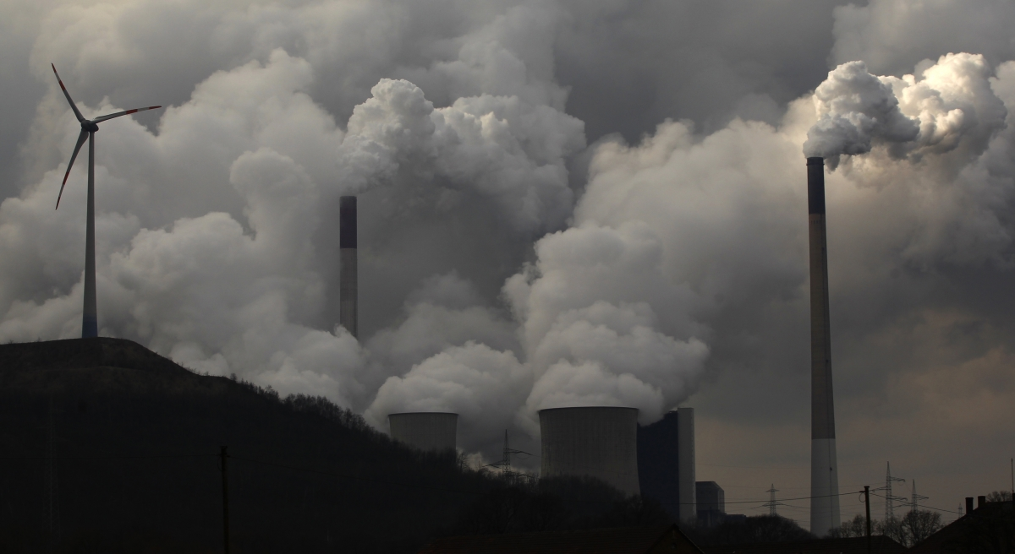
Paper Products/Cardboard-Energy to Produce/Recycle

Slide 15
Natural Resources: Aluminum
https://www.youtube.com/watch?v=fa6KEwWY9HU

Slide 16
Natural resources: Aluminum

Slide 17
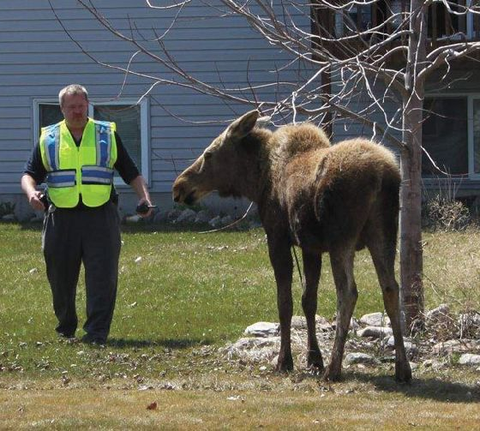
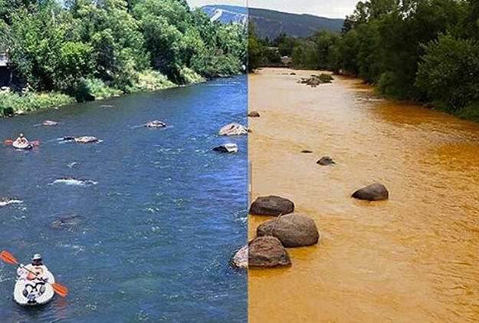
Aluminum-Cost to Animals/Environment

Slide 18
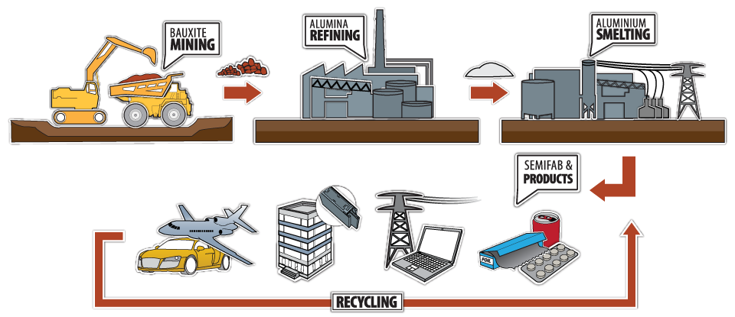
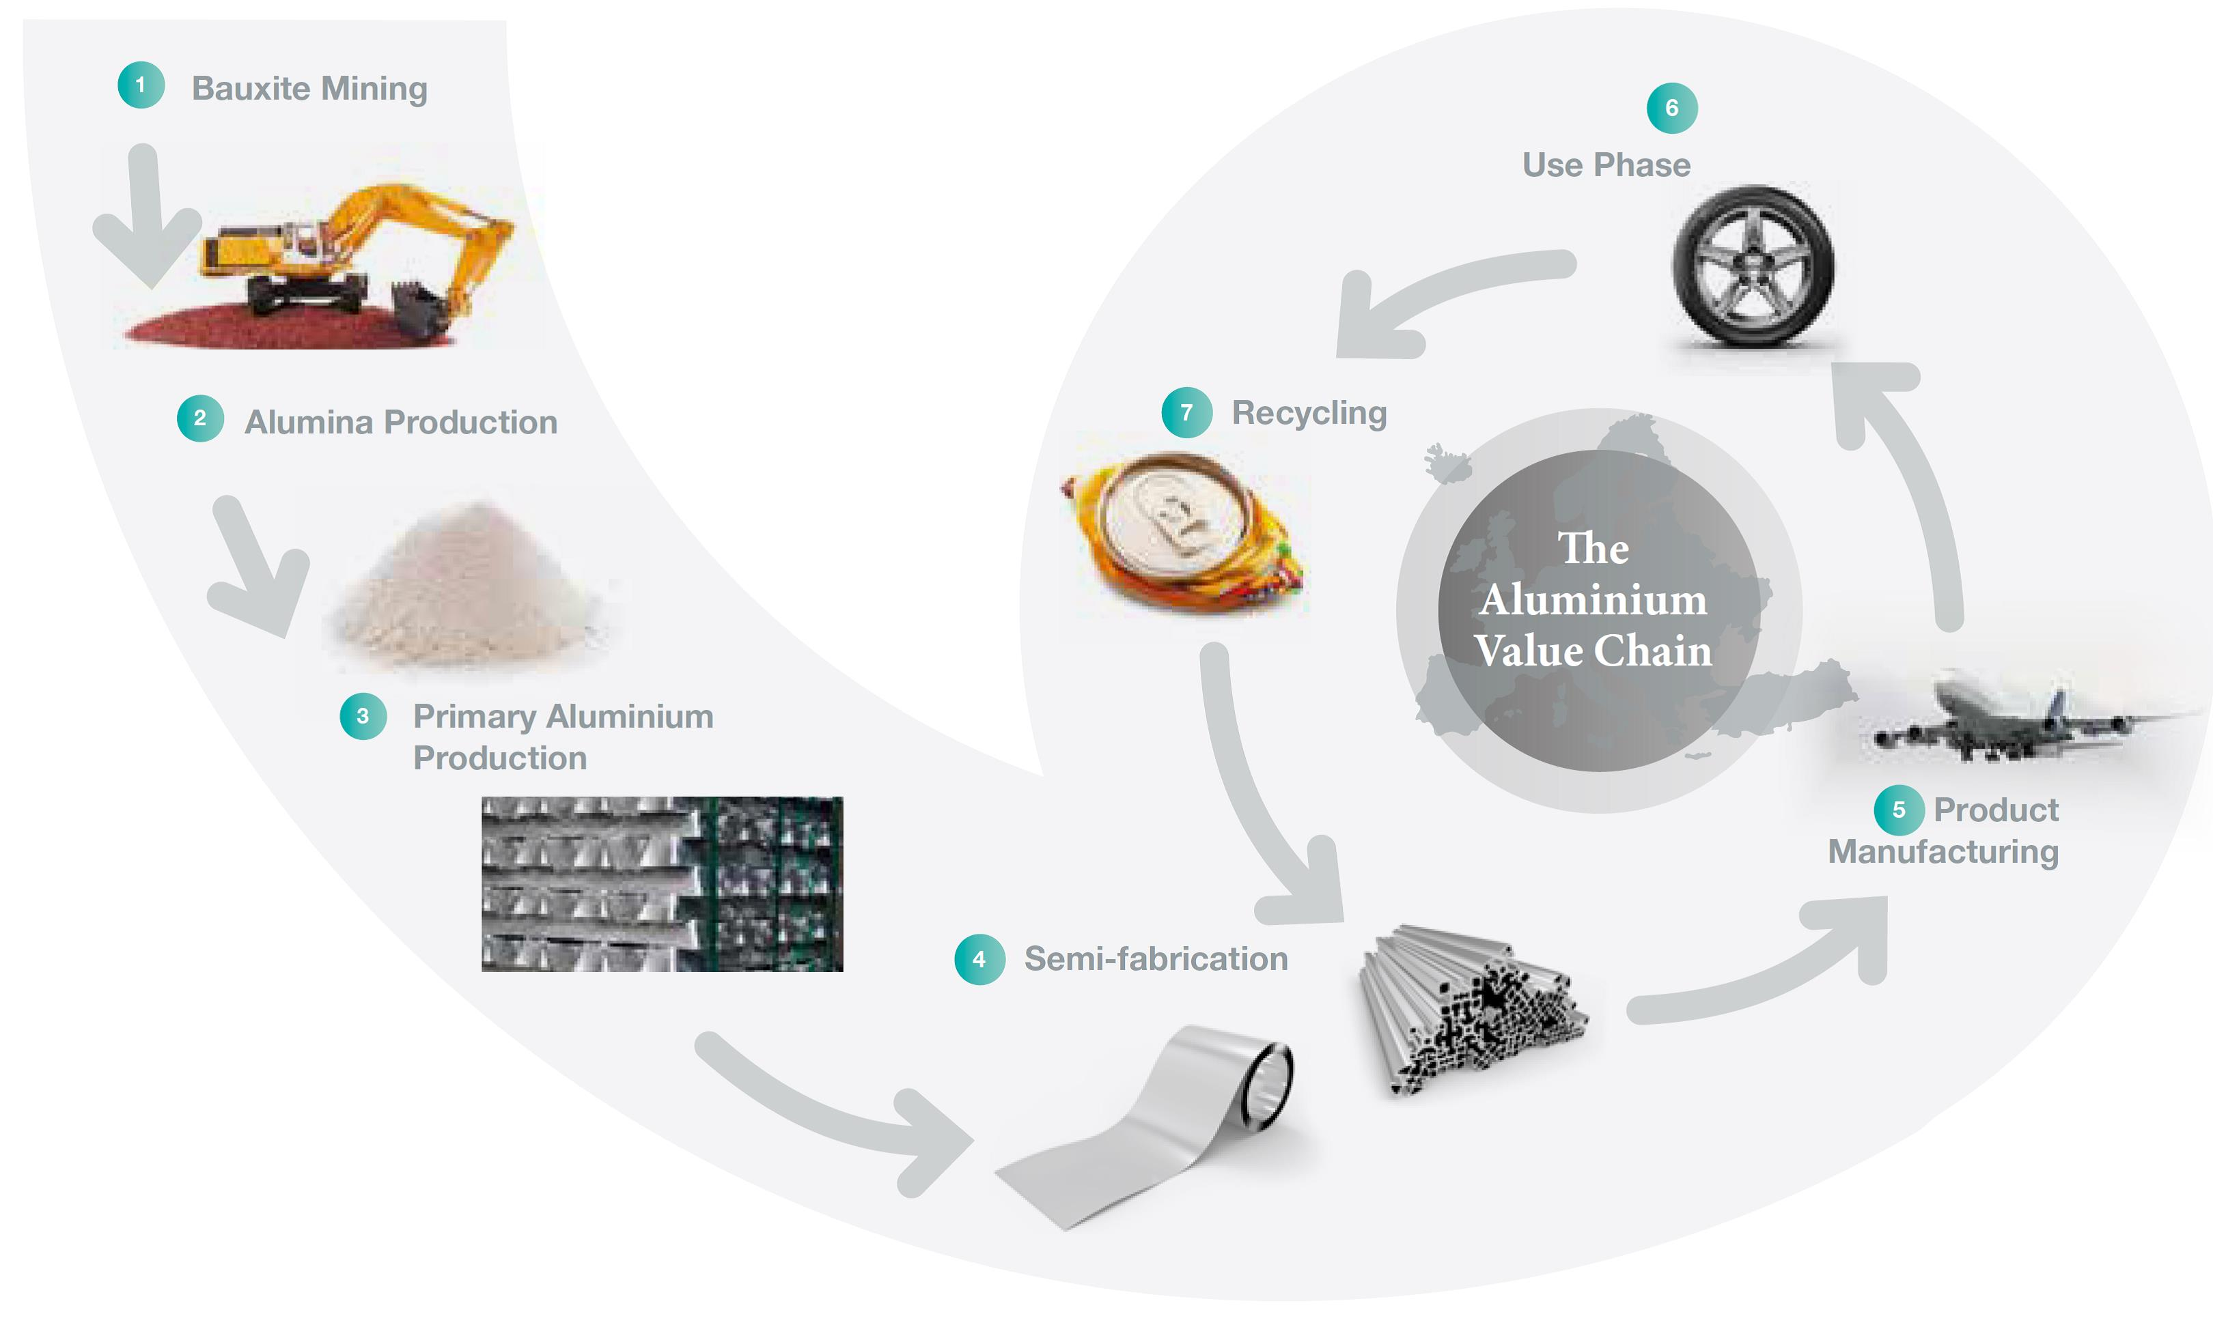
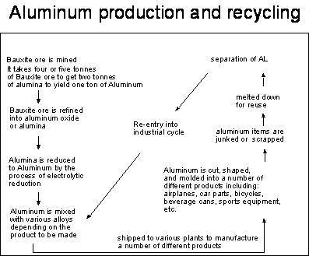
Aluminum-Production and Transportation
Aluminum-
production process

Slide 19
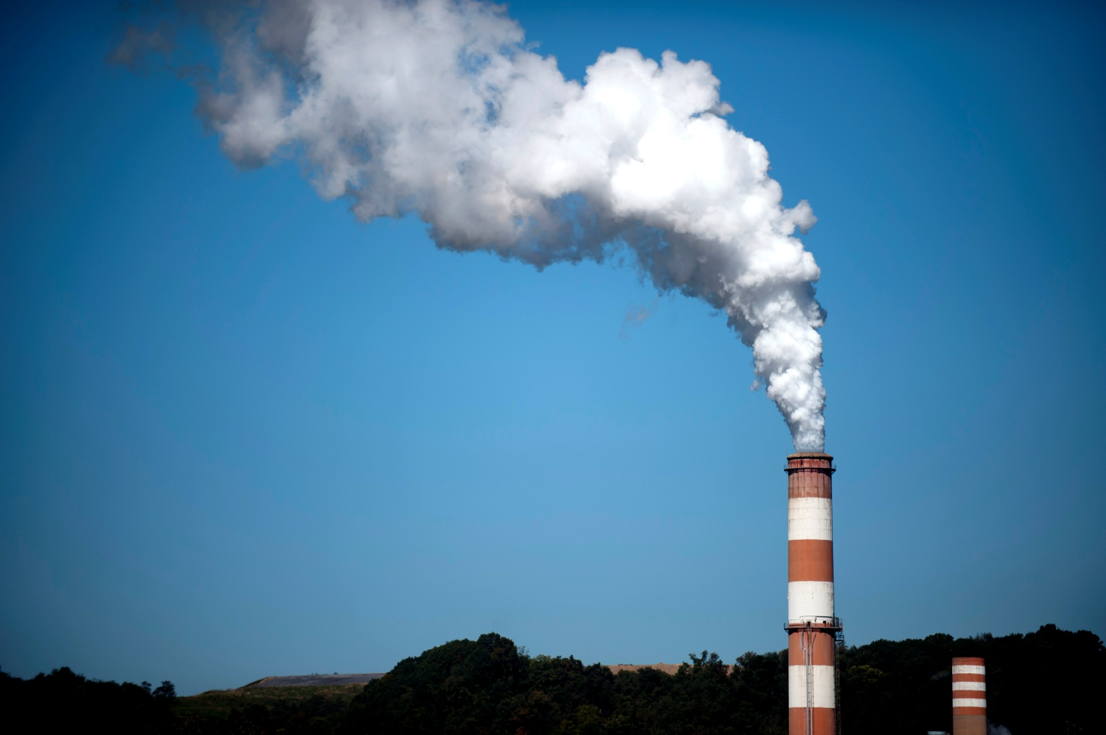
Aluminum-Energy to Produce/Recycle

Slide 20
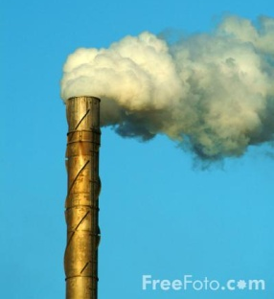
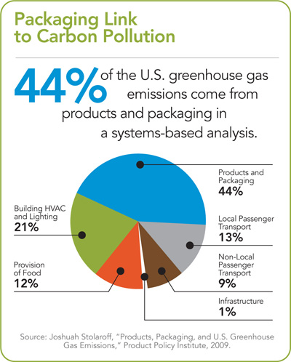
Emissions during production and transportation
Plastic
Paper
Aluminum

Slide 21
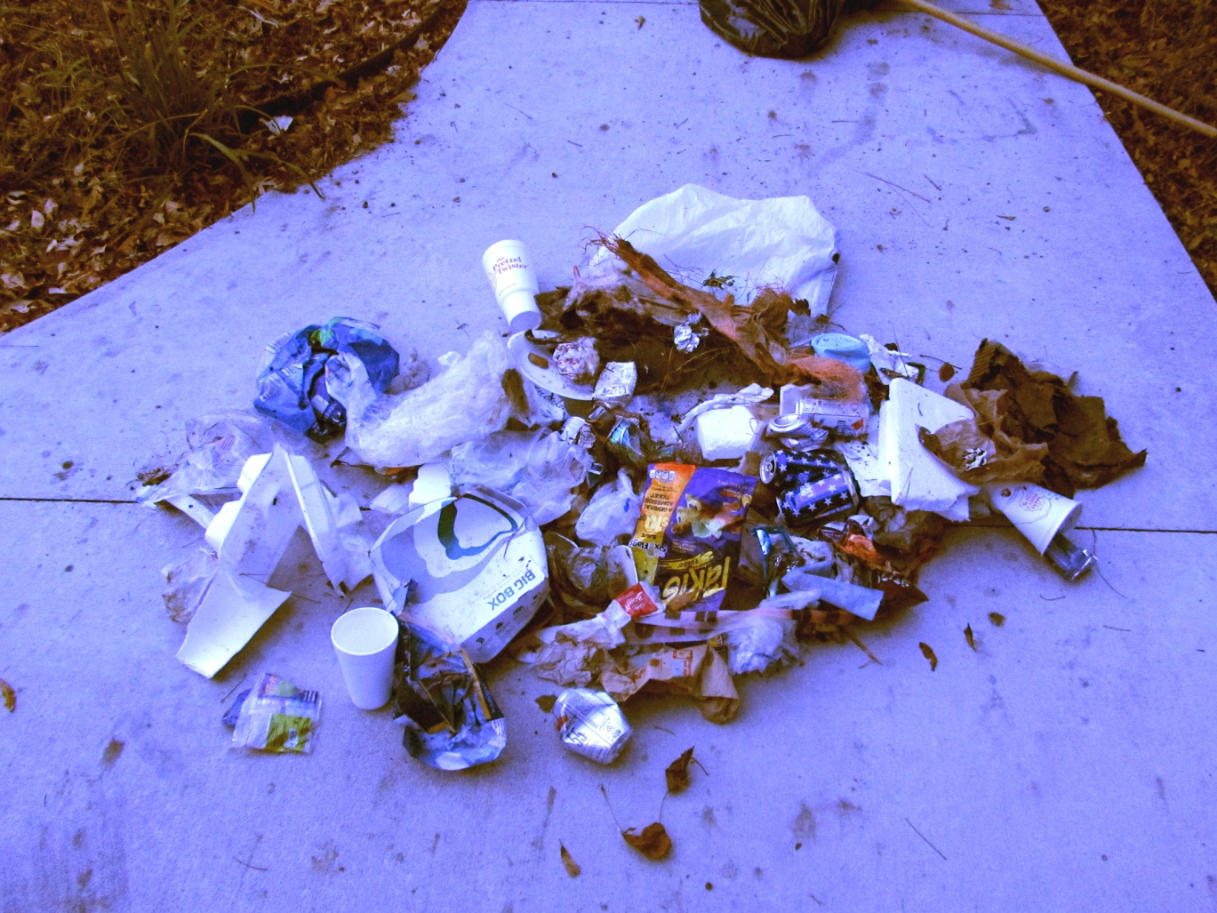
Cost of Cleanup
Brewster Camp Ground
Three hours
of cleanup=$30
labor cost

Slide 22
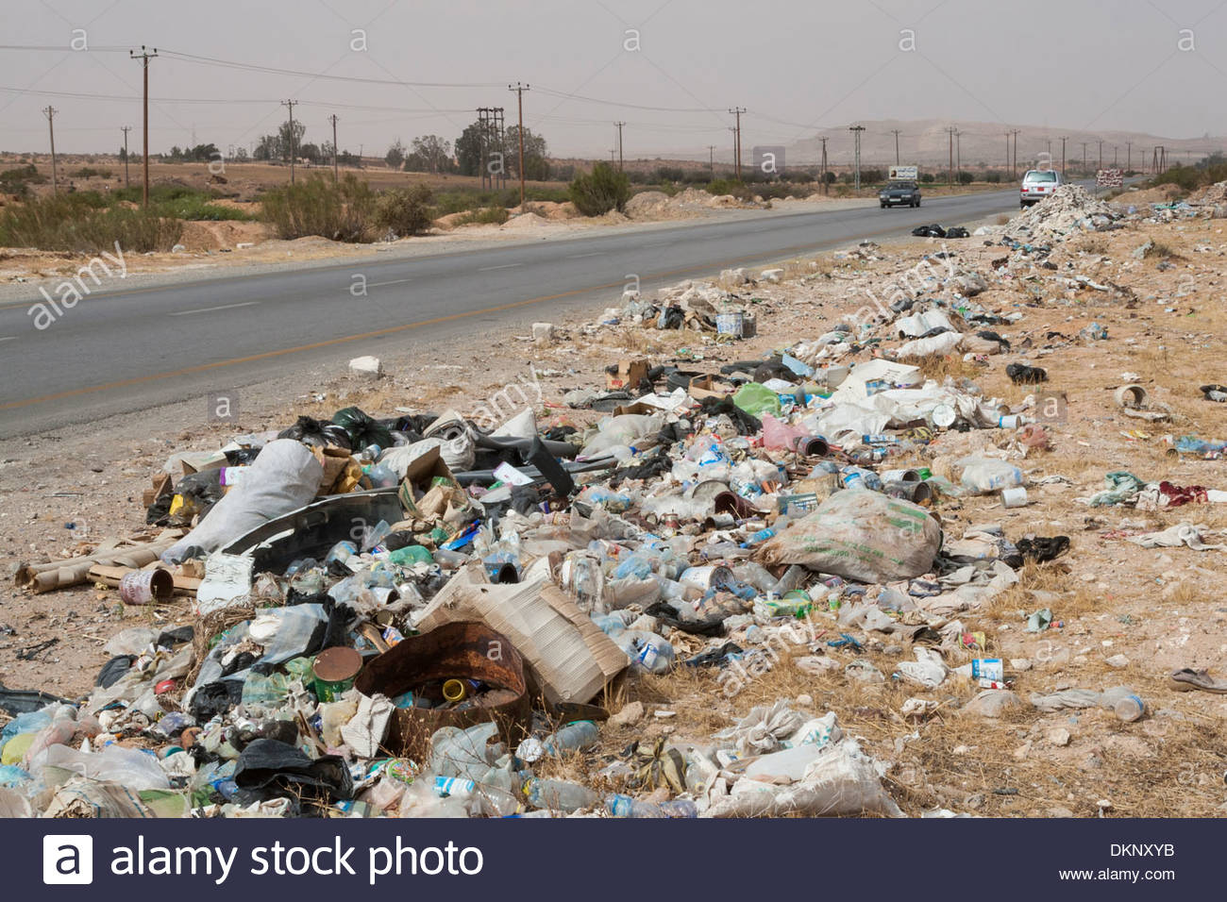
Cost of Cleanup-Roadside Trash

Slide 23
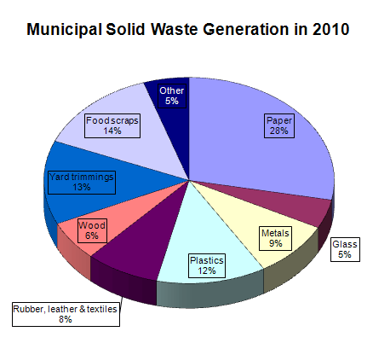
What can you do to decrease the total amount of waste?
Pie chart

Slide 24
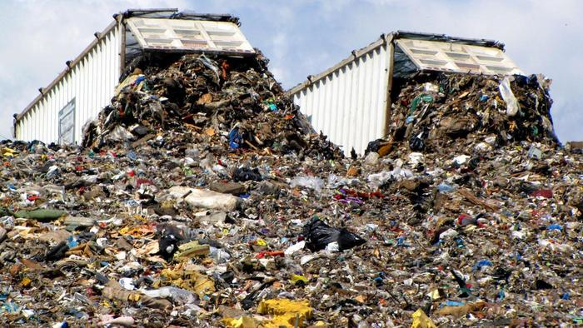
Cost of Cleanup-Landfill

Slide 25
Timeline

Slide 26
What’s your order?
Cost of Packaging

Slide 27
Conclusion

